Slide 1
CURSO DE ARDUINO
ORIENTADO A LA ADQUISICIÓN DE DATOS
Clase 3: Estructuras de flujo y Arrays

Slide 2
Estructura de control if
Description
The if statement checks for a condition and executes the proceeding statement or set of statements if the condition is 'true'.
Syntax
if (condition) {
//statement(s)
}
Parameters
condition: a boolean expression (i.e., can be true or false).

Slide 3
Estructura de control if
Description
Syntax
if (condition1) {
// do Thing A
}
else if (condition2) {
// do Thing B
}
else {
// do Thing C
}

Slide 4
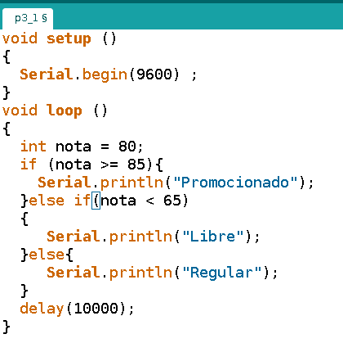
Programa 3.1
Actividad
Copiar y compilar
el programa
Cargarlo en la
placa ARDUINO
UNO
Añadir Comentarios

Slide 5
Estructura de control while
Description
A while loop will loop continuously, and infinitely, until the expression inside the parenthesis, () becomes false. Something must change the tested variable, or the while loop will never exit. This could be in your code, such as an incremented variable, or an external condition, such as testing a sensor.
Syntax
while (condition) {
// statement block
} ;
Parameters
condition: a boolean expression that evaluates to true or false.

Slide 6
Estructura de control do...while
Description
The do…​while loop works in the same manner as the while loop, with the exception that the condition is tested at the end of the loop, so the do loop will always run at least once.
Syntax
do {
// statement block
} while (condition);
Parameters
condition: a boolean expression that evaluates to true or false.

Slide 7
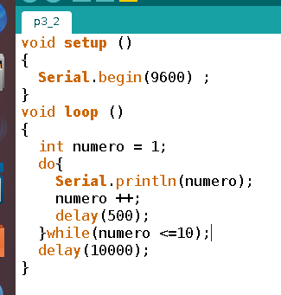
Programa 3.2: Cuenta del 1 al 10
Actividad
Copiar y compilar
el programa
Cargarlo en la
placa ARDUINO
UNO
Añadir Comentarios

Slide 8
Estructura de control for
Description
The for statement is used to repeat a block of statements enclosed in curly braces. An increment counter is usually used to increment and terminate the loop. The for statement is useful for any repetitive operation, and is often used in combination with arrays to operate on collections of data/pins.
Syntax
for (initialization; condition; increment) {
// statement(s);
}
Parameters
condition: a boolean expression that evaluates to true or false.

Slide 9
Estructura de control for
Syntax
for (initialization; condition; increment) {
// statement(s);
}
Parameters
initialization: happens first and exactly once.
condition: each time through the loop, condition is tested; if it’s true, the statement block, and the increment is executed, then the condition is tested again. When the condition becomes false, the loop ends.
increment: executed each time through the loop when condition is true.

Slide 10
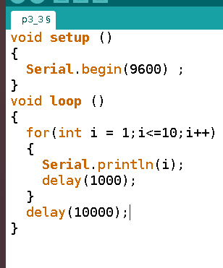
Programa 3.3: Cuenta del 1 al 10
Actividad
Copiar y compilar
el programa
Cargarlo en la
placa ARDUINO
UNO
Añadir Comentarios

Slide 11
Array
Description
An array is a collection of variables that are accessed with an index number. Arrays in the C++ programming language Arduino sketches are written in can be complicated, but using simple arrays is relatively straightforward.
}
Creating (Declaring) an Array
int myInts[6];
int myPins[] = {2, 4, 8, 3, 6};
int mySensVals[6] = {2, 4, -8, 3, 2};
char message[6] = "hello";

Slide 12
Array
To assign a value to an array:
MySensVals[0] = 10;
To retrieve a value from an array:
x = mySensVals[4];

Slide 13
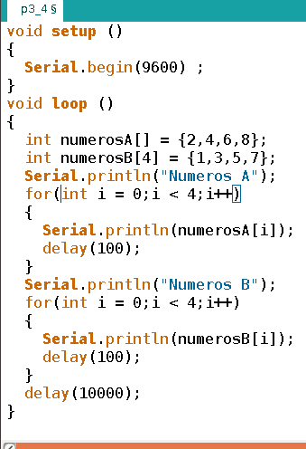
Programa 3.4: Números Pares
Actividad
Copiar y compilar
el programa
Cargarlo en la
placa ARDUINO
UNO
Añadir Comentarios

Slide 14
Programa 3.5: Promedios y Desviación
Realice un programa que
1) Guarde almacene una muestra de
diez números decimales en un array.
2) Calcule el promedio de los mismos
(con una estructura de ciclo o bucle)
3) Muestre el valor y calcule la varianza
la de la muestra

Slide 15
Fin de la Clase 3
Bibliografía:
Wikipedia: https://es.wikipedia.org/wiki/Arduino
Página Oficial de Arduino: https://www.arduino.cc/en/Tutorial/Memory
https://www.arduino.cc/reference/en/
Licencia Creative Commons
Esta obra está bajo una Licencia Creative Commons Atribución 4.0 Internacional.

